Slide 1

School of Computer science and engineering
Course Code : BEE01T1003 Course Name:BEEE
Topic: MAGNETIC CIRCUITS
Section-11
1. Ayush Raj 21SCSE1011010
2. Harsh Yadav 21SCSE1290026
3. Divyansh Rawat 21SCSE1010996
4. MD Wasim Akram 21SCSE1011034
5. Vaibhav Singh 21SCSE1010992
Program Name:B.Tech

Slide 2
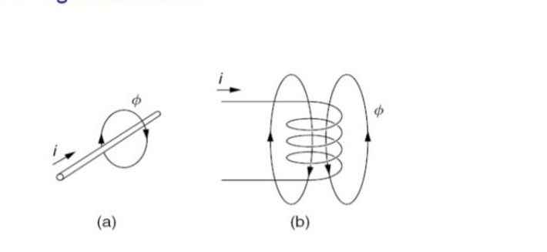
School of Computer science and engineering
Course Code : BBS01T1008 Course Name: BEEE
Electrical current flowing along a wire creates a magnetic field around the wire, as shown in Fig. That magnetic field can be visualized by showing lines of magnetic flux, which are represented with the symbol Φ
The direction of that field that can be determined using the "right hand rule"
Program Name:B.Tech

Slide 3
School of Computer science and engineering
Course Code : BEE01T1003 Course Name: BEEE
Faraday discovered is that current flowing through the coil notonly creates a magnetic field in the iron, it also creates a voltage across the coil that is proportional to the rate of change of magnetic flux Φ in the iron.
That voltage is called an electromotive force, or emf, and is designated by the symbol e.
Faraday's law of electromagnetic induction:
e = N (dΦ/dt.)
The sign of the induced emf is always in a direction that opposes the current that created it, a phenomenon referred to as Lenz's law.
Program Name:B.Tech

Slide 4
School of Computer science and engineering
Course Code : BEE01T1003 Course Name: BEEE
In the magnetic circuit of Fig, the driving force, analogous to voltage, is called the magneto motive force (mmf), designated by F. The magneto motive force is created by wrapping N turns of wire, carrying current i
Magneto motive force (mmf )F = Ni (ampere – turn)
The magnetic flux is proportional to the mmf driving force and inversely proportional to a quantity called reluctance R, which is analogous to electrical resistance,
resulting in the "Ohm's law" of magnetic circuits given by f= R.Φ
reluctance = R = l/μA (A-t/ Wb)
Magnetic flux density B = Φ/A webers/m^2or teslas (T)
Electric current density J = i/A
Program Name:B.Tech

Slide 5
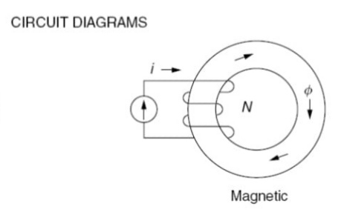
School of Computer science and engineering
Course Code : BEE01T1003 Course Name: BEEE
A Magnetic field intensity (H):
With N turns of wire carrying current i, the mmf created in the circuit is Ni ampere-turns. With ‘l’ representing the mean path length for the magnetic flux, the magnetic field intensity is
Magnetic field intensity H =Ni/l
ampere-turns/meter
B = μH
What is relation between B and H?
Magnetic field strength or filed intensity (H) is the amount of magnetising force. Magnetic flux density (B) is the amount of magnetic force induced on the given body due to the magnetising force H. The relation between B and H is, B = μH.
Program Name:B.Tech

Slide 6
School of Computer science and engineering
Course Code : BEE01T1003 Course Name: BEEE
Faraday's Laws:
First law: EMF is induced in a coil whenever magnetic field linking that coil is changed.
Second law: The magnitude of the induced EMF is proportional to the rate of change of flux linkage
.e= - N (dΦ/dt.)
Lenz's law: This law states that the induced EMF due to change of flux linkage by a coil will produce a current in the coil in such a direction that it will produce a magnetic field which will oppose the cause, that is the change in flux linkage.
Program Name:B.Tech

Slide 7
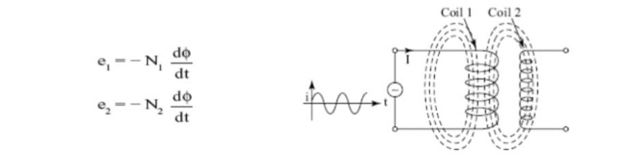
School of Computer science and engineering
Course Code : BEE01T1003 Course Name: BEEE
Self-induced EMF and Mutually induced EMF
The EMF induced in a coil due to change in flux linkage when a changing current flows through the coil is called self-induced EMF.
when a second coil is brought near a coil producing changing flux, EMF will be induced in the second coil due to change in current in the first coil. This is called mutually induced EMF.
Program Name:B.Tech

Slide 8
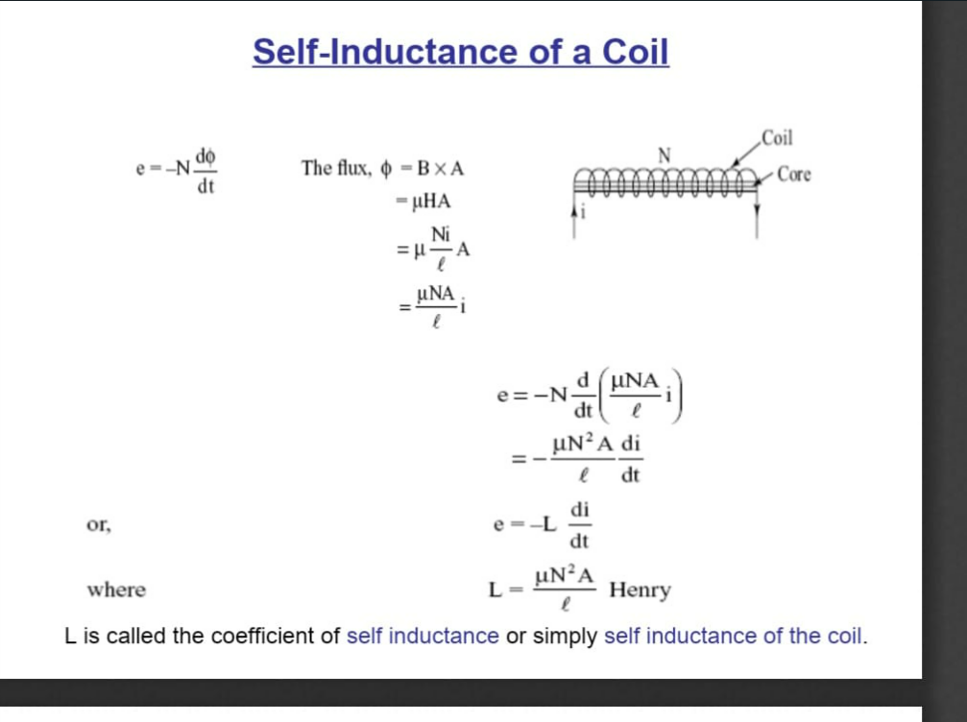
School of Computer science and engineering
Course Code : BEE01T1003 Course Name: BEEE
Self inductance is defined as the induction of a voltage in a current-carrying wire when the current in the wire itself is changing. In the case of self-inductance, the magnetic field created by a changing current in the circuit itself induces a voltage in the same circuit.
Self-inductance is the tendency of a coil to resist changes in current in itself. Whenever current changes through a coil, they induce an EMF, which is proportional to the rate of change of current through the coil.
Program Name:B.Tech

Slide 9
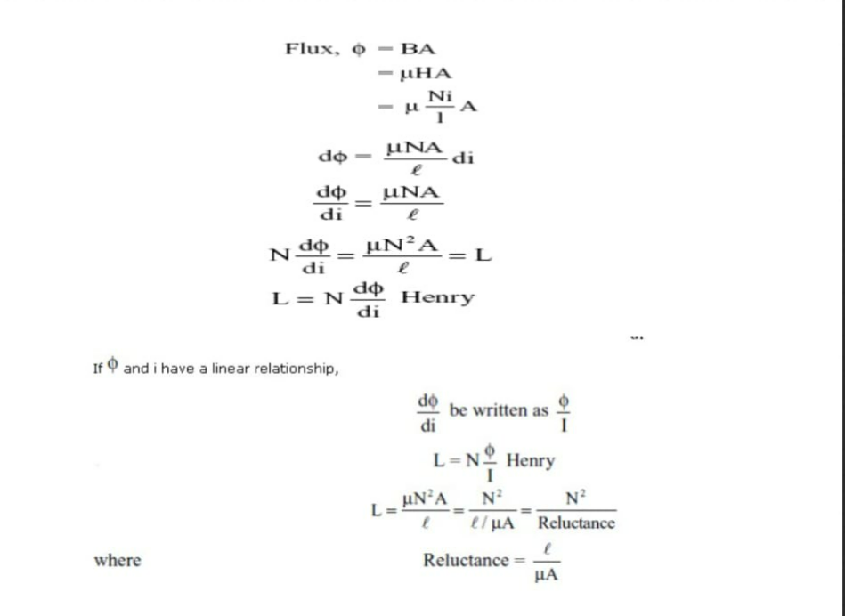
School of Computer science and engineering
Course Code : BEE01T1003 Course Name: BEEE
Program Name:B.Tech

Slide 10
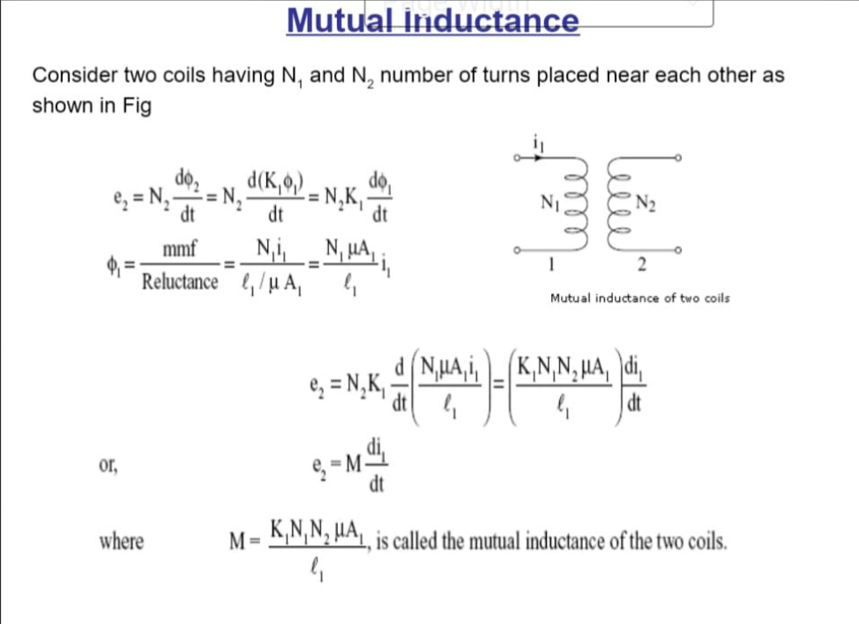
School of Computer science and engineering
Course Code : BEE01T1003 Course Name: BEEE
Mutual inductance, M, is the property whereby an e.m.f. is induced in a circuit by a change of flux due to current changing in an adjacent circuit
when two coils are brought in proximity with each other the magnetic field in one of the coils tend to link with the other. This further leads to the generation of voltage in the second coil. This property of a coil which affects or changes the current and voltage in a secondary coil is called mutual inductance.
Mutual inductance between two coils depends on permeability of core, the number of their turns and cross sectional area of the common core. Mutual inductance of the coils also depends on their separation as well as their relative orientation.
Program Name:B.Tech

Slide 11
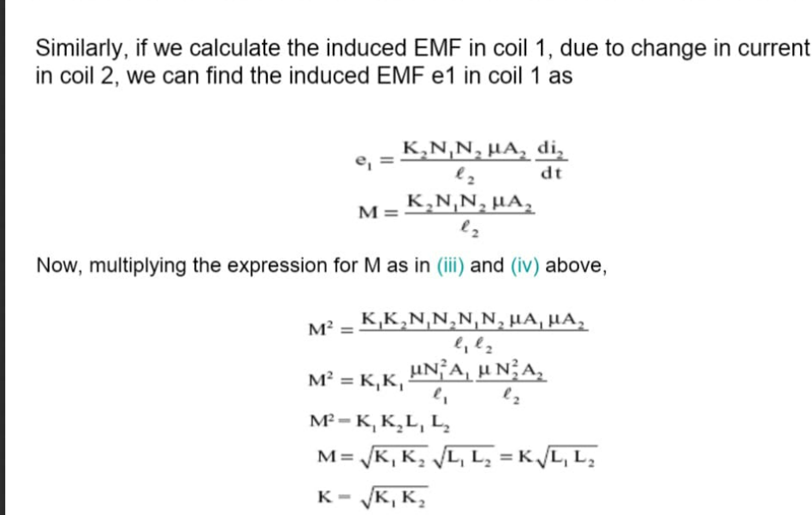
School of Computer science and engineering
Course Code : BEE01T1003 Course Name: BEEE
Program Name:B.Tech

Slide 12


